Slide 1
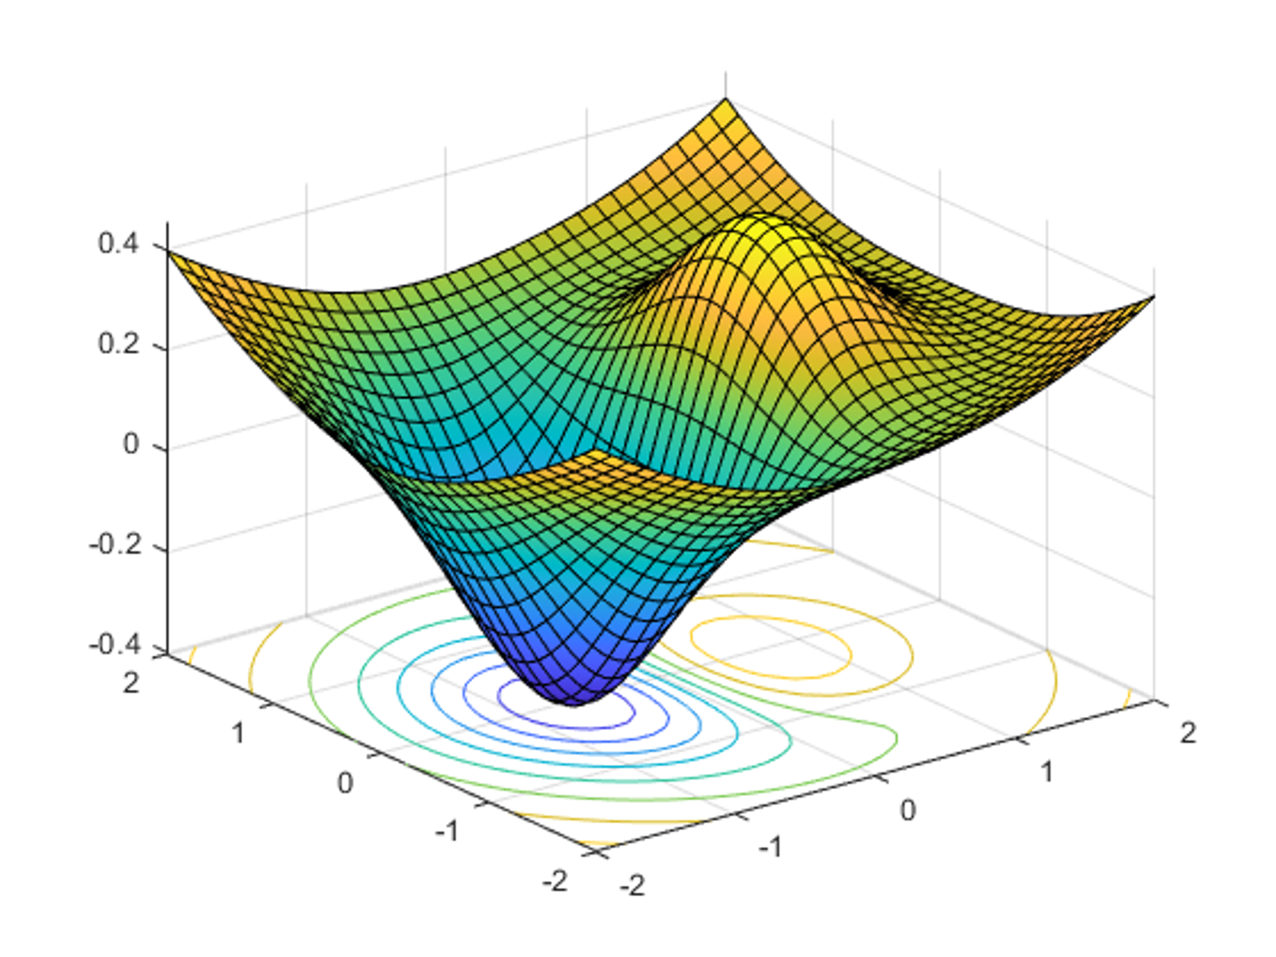


DATA 585 Optimization
Picture generated on MATLAB using
f = @(x,y) x.*exp(-x.^2-y.^2)+(x.^2+y.^2)/20;
fsurf(f,[-2,2],'ShowContours','on’)
Code example from https://www.mathworks.com/help/optim/ug/optimization-toolbox-tutorial.html
Instructor: Yves Lucet
$$\min{\{f\left(x\right):g\left(x\right)≤0;h\left(x\right)=0;x∈S\}}$$
We respectfully acknowledge the Syilx Okanagan Nation and their peoples, in whose traditional, ancestral, unceded territory UBC Okanagan is situated.

Slide 2

Menu: 1D
Derivative
Fermat
Minimizer local/global and convexity
Gradient descent
Backtracking
Newton
Image courtesy of Gregory Szarkiewicz / FreeDigitalPhotos.net

Slide 3
Lab 1
Classify problem:
linear/quadratic/nonlinear
smooth/nonsmooth
Constrained/unconstrained
Integer/continuous variables
Convex/nonconvex
Size: small/medium/large [depends on problem type]
Deduce expectations: local/global min; fast/slow/impossible computation time
Pick function to call in your library
Function should not crash (constraints with unconstrained function, etc.)
Function should be appropriate: if smooth, use derivatives
Function should return what you are looking for: local vs. global

Slide 4
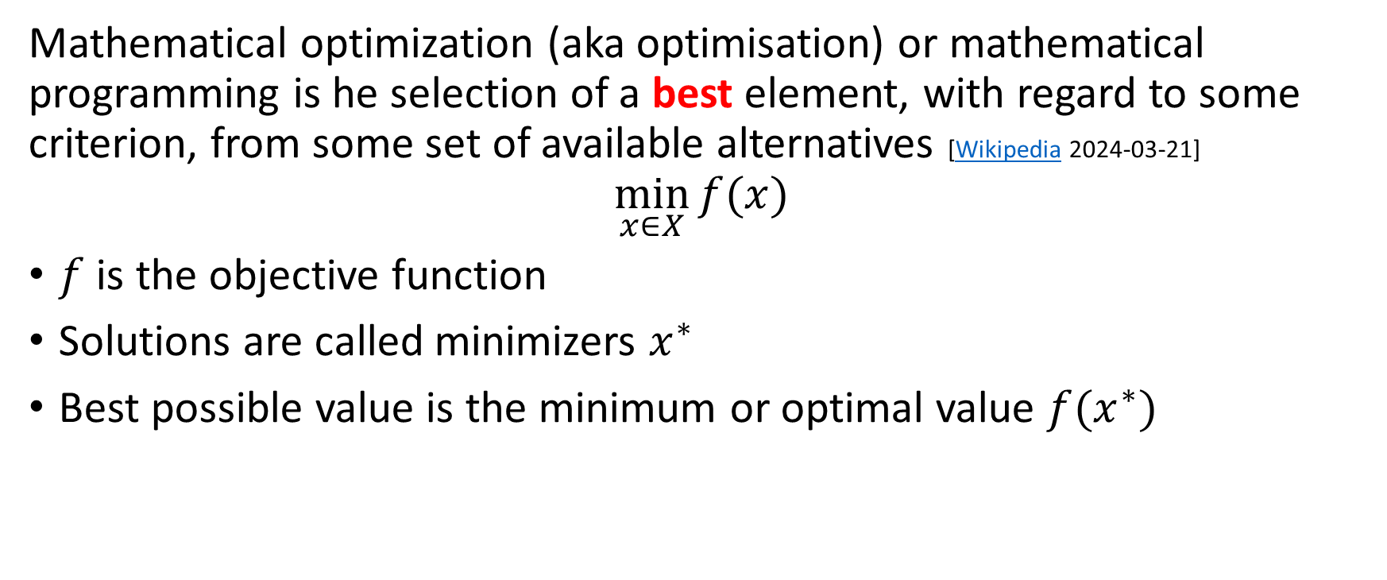
What is optimization?
Mathematical optimization (aka optimisation) or mathematical programming is he selection of a best element, with regard to some criterion, from some set of available alternatives [Wikipedia 2024-03-21]
$$\min_{x∈X}{f(x)}$$
$f$ is the objective function
Solutions are called minimizers $x^{∗}$
Best possible value is the minimum or optimal value $f(x^{∗})$

Slide 5
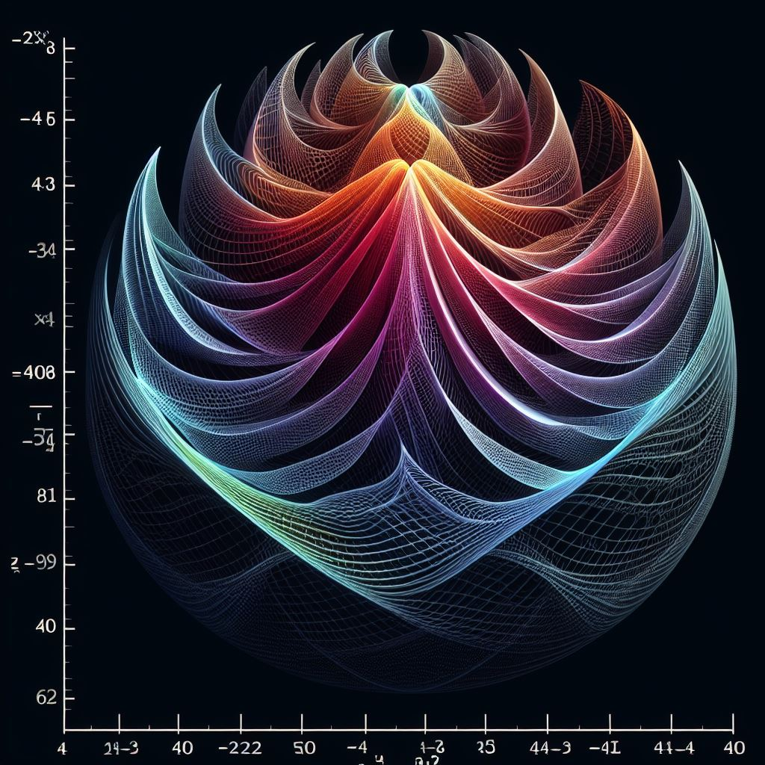

Example
$$f\left(x\right)=x^{2}−4x+7$$
Plot of the function f(x)=x*x-4x+7 on the interval [0,4] with y-axis value in [2.5,8]
Copilot:
Generated with AI ∙ March 21, 2024 at 12:26 PM

Slide 6
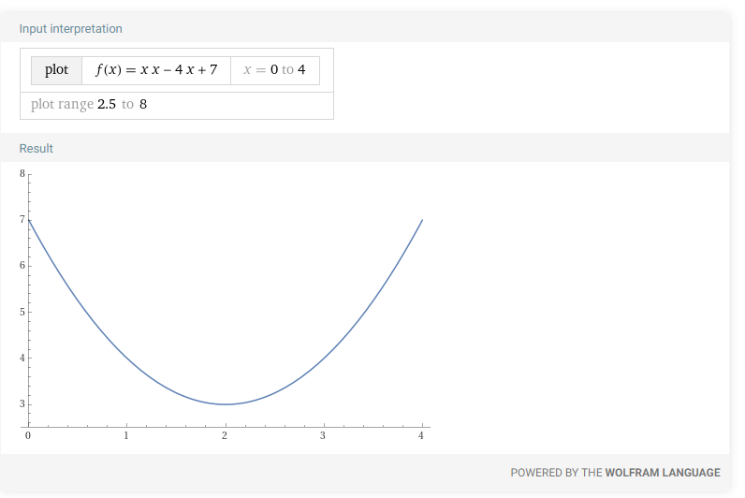
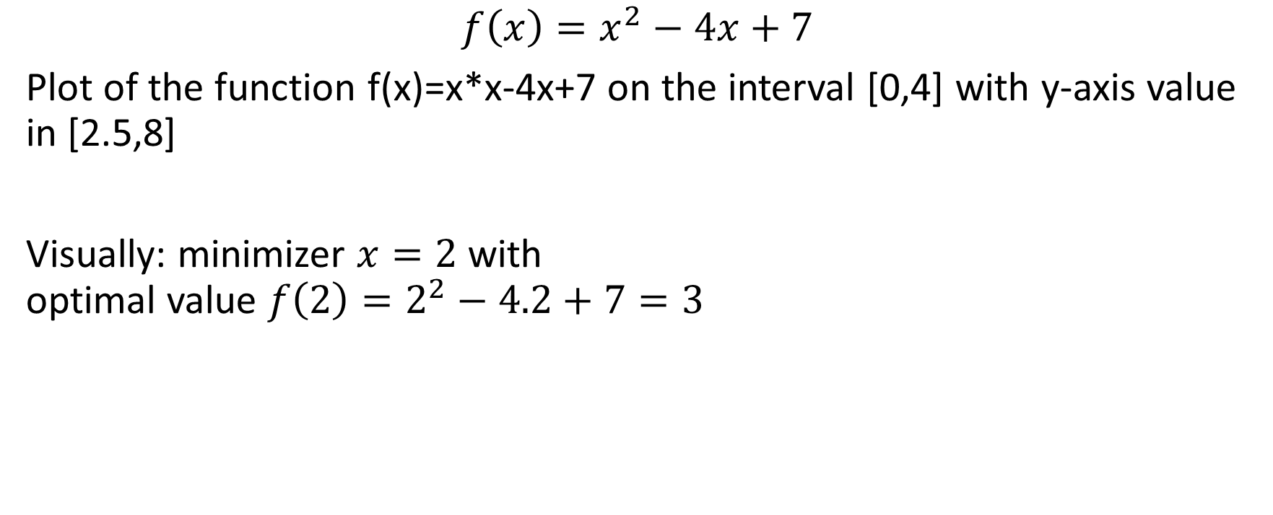
Example
$$f\left(x\right)=x^{2}−4x+7$$
Plot of the function f(x)=x*x-4x+7 on the interval [0,4] with y-axis value in [2.5,8]
Visually: minimizer $x=2$ with optimal value $f\left(2\right)=2^{2}−4.2+7=3$
WolframAlpha

Slide 7
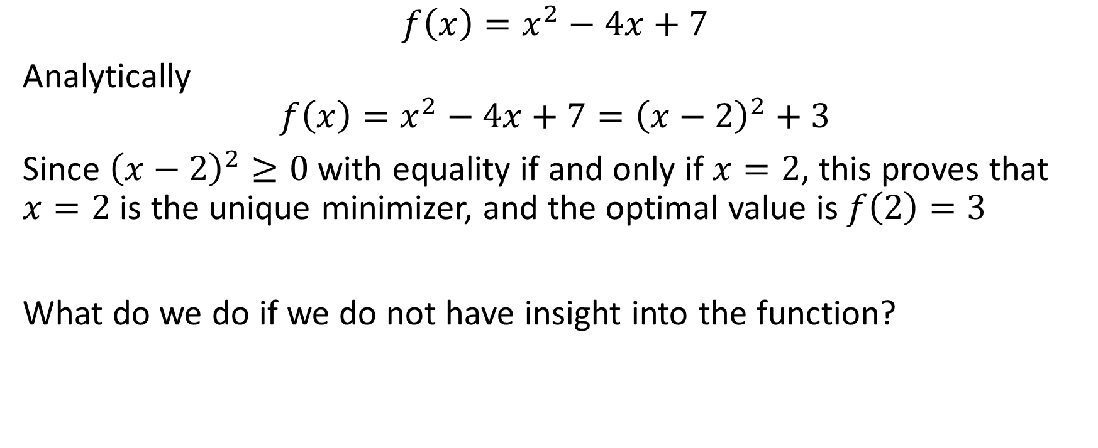
Example
$$f\left(x\right)=x^{2}−4x+7$$
Analytically
$$f\left(x\right)=x^{2}−4x+7={\left(x−2\right)}^{2}+3$$
Since ${\left(x−2\right)}^{2}≥0$ with equality if and only if $x=2$, this proves that $x=2$ is the unique minimizer, and the optimal value is $f\left(2\right)=3$
What do we do if we do not have insight into the function?

Slide 8
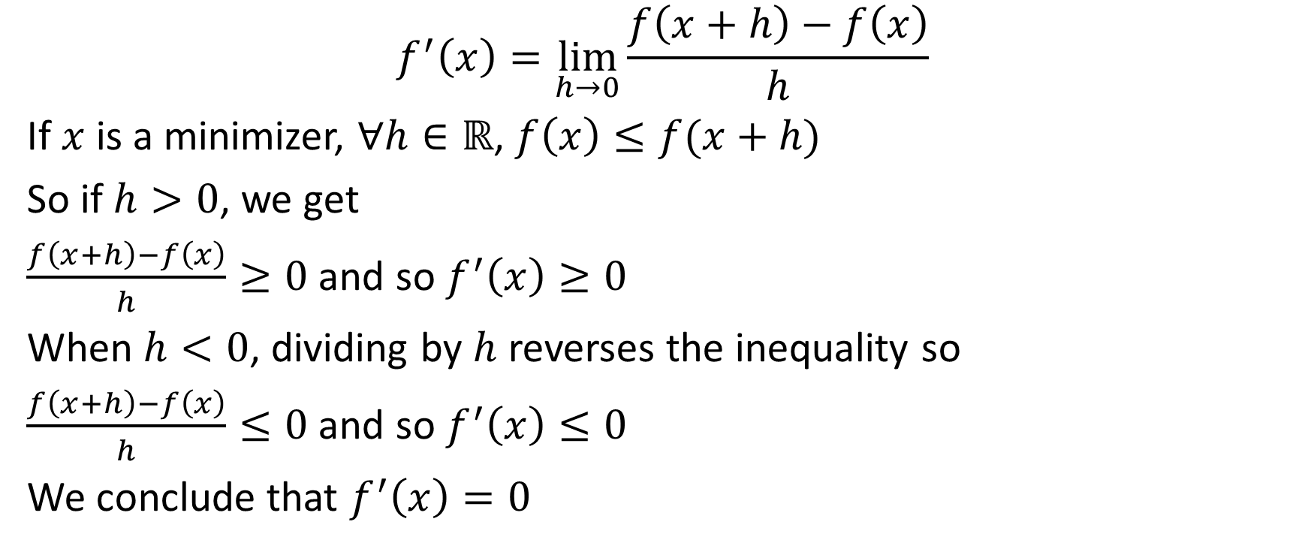
Calculus
$$f^{′}\left(x\right)=\lim_{h→0}\frac{f\left(x+h\right)−f\left(x\right)}{h}$$
If $x$ is a minimizer, $∀h∈ℝ$, $f\left(x\right)≤f(x+h)$
So if $h>0$, we get
$\frac{f\left(x+h\right)−f\left(x\right)}{h}≥0$ and so $f^{′}\left(x\right)≥0$
When $h<0$, dividing by $h$ reverses the inequality so
$\frac{f\left(x+h\right)−f\left(x\right)}{h}≤0$ and so $f^{′}\left(x\right)≤0$
We conclude that $f^{′}\left(x\right)=0$

Slide 9
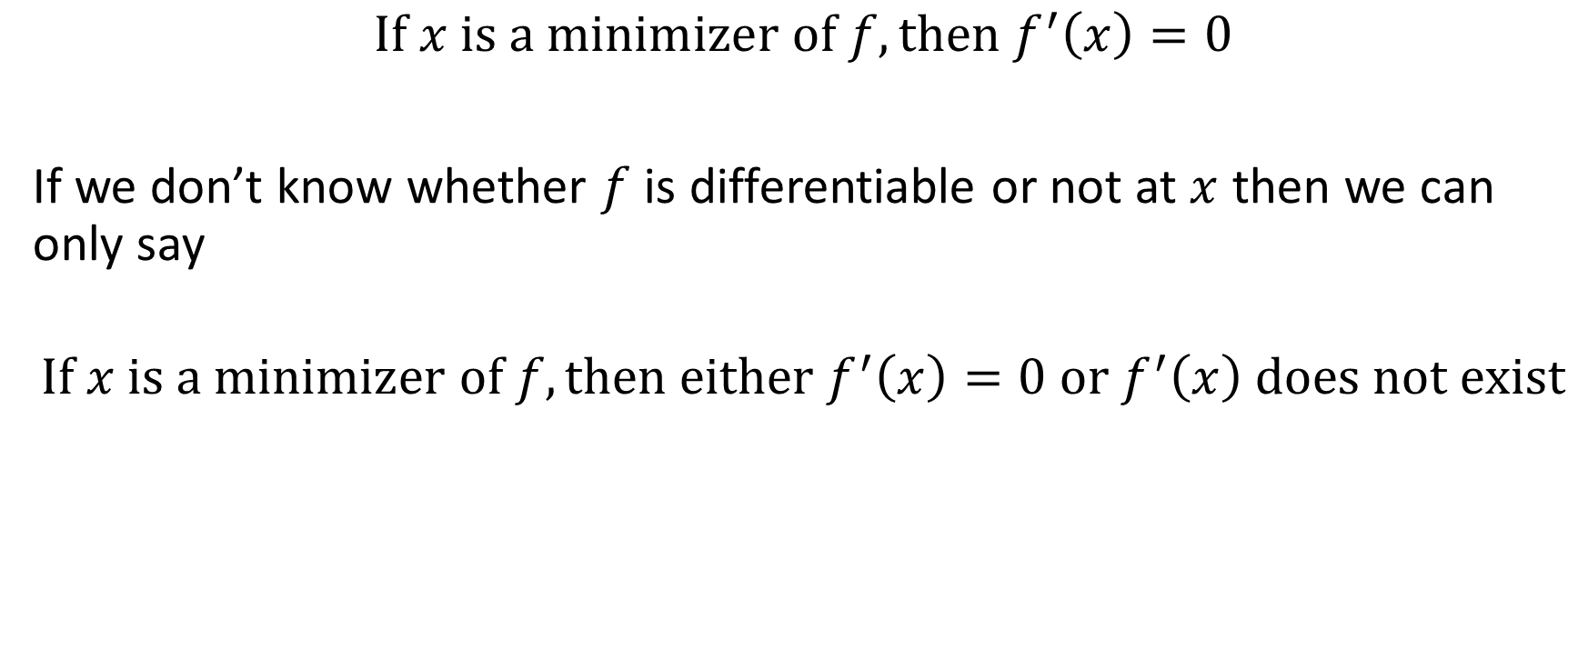
Fermat’s rule
$$If x is a minimizer of f, then f^{′}\left(x\right)=0$$
If we don’t know whether $f$ is differentiable or not at $x$ then we can only say
$$If x is a minimizer of f, then either f^{′}\left(x\right)=0 or f^{′}\left(x\right) does not exist$$

Slide 10
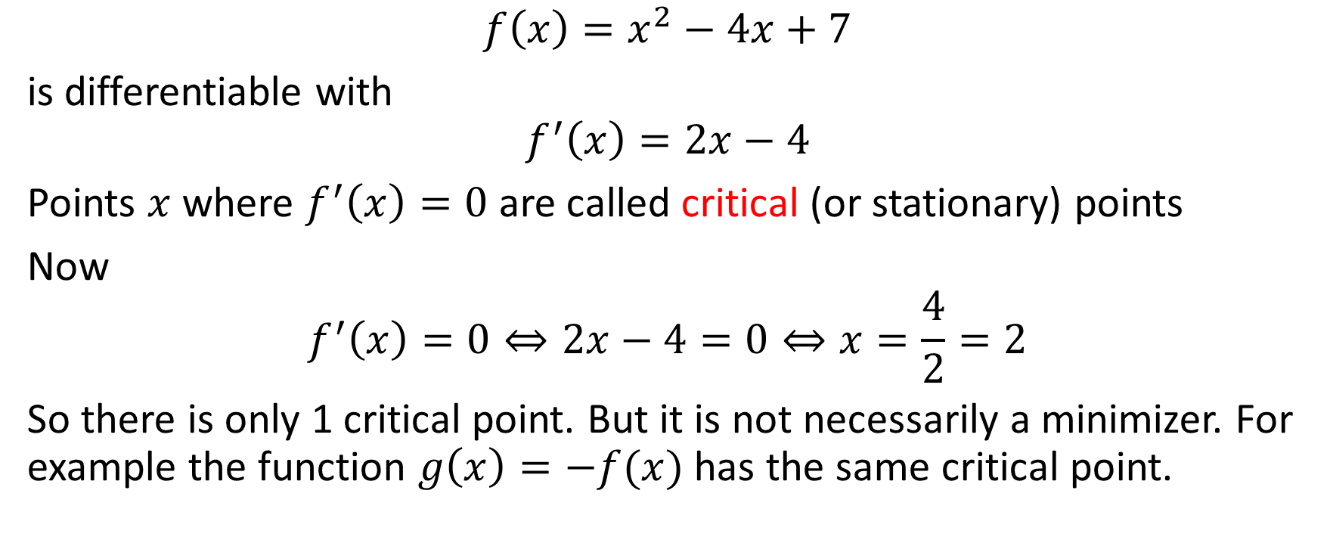
Example
$$f\left(x\right)=x^{2}−4x+7$$
is differentiable with
$$f^{′}\left(x\right)=2x−4$$
Points $x$ where $f^{′}\left(x\right)=0$ are called critical (or stationary) points
Now
$$f^{′}\left(x\right)=0⇔2x−4=0⇔x=\frac{4}{2}=2$$
So there is only 1 critical point. But it is not necessarily a minimizer. For example the function $g\left(x\right)=−f(x)$ has the same critical point.

Slide 11
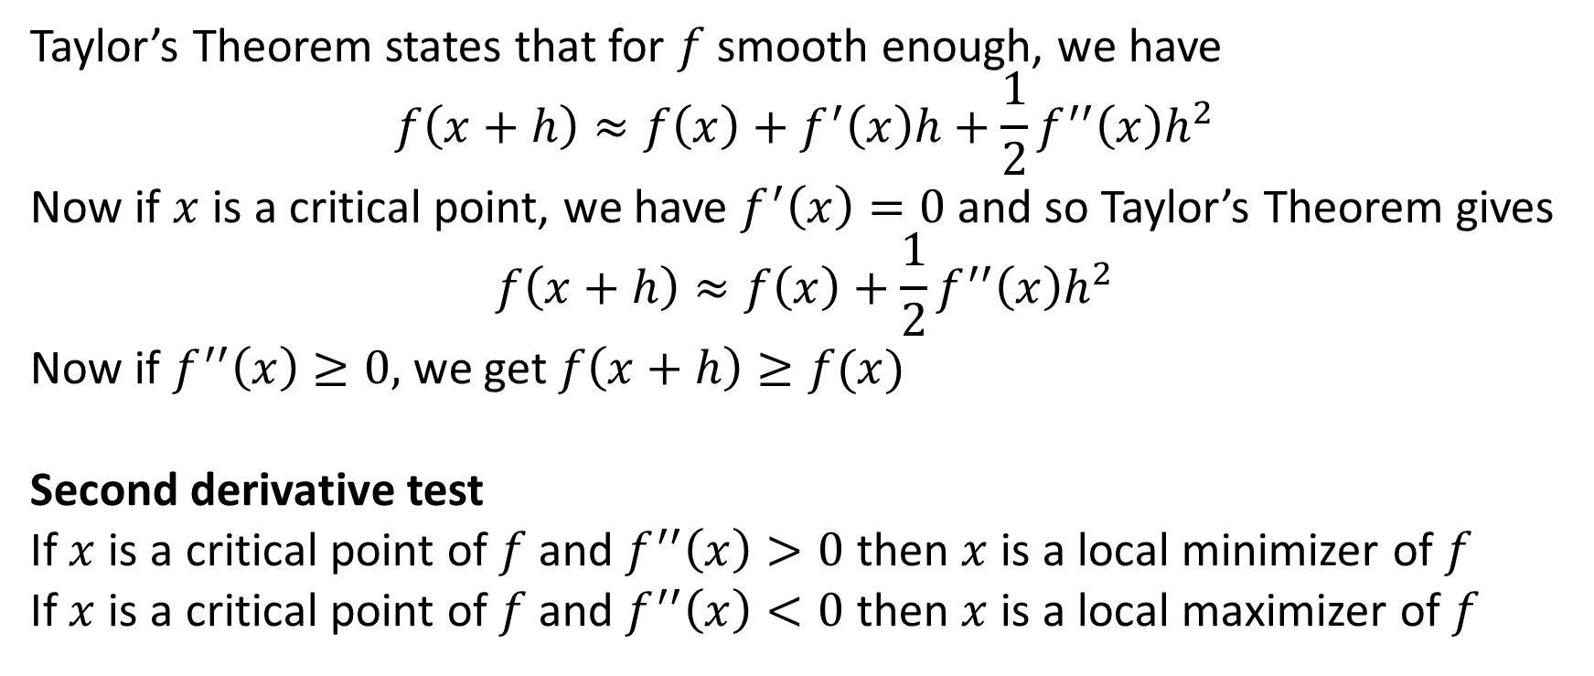
Taylor’s Theorem
Taylor’s Theorem states that for $f$ smooth enough, we have
$$f\left(x+h\right)≈f\left(x\right)+f^{′}\left(x\right)h+\frac{1}{2}f^{′′}\left(x\right)h^{2}$$
Now if $x$ is a critical point, we have $f^{′}\left(x\right)=0$ and so Taylor’s Theorem gives
$$f\left(x+h\right)≈f\left(x\right)+\frac{1}{2}f^{′′}\left(x\right)h^{2}$$
Now if $f^{′′}\left(x\right)≥0,$ we get $f\left(x+h\right)≥f(x)$
Second derivative test
If $x$ is a critical point of $f$ and $f^{′′}\left(x\right)>0$ then $x$ is a local minimizer of $f$
If $x$ is a critical point of $f$ and $f^{′′}\left(x\right)<0$ then $x$ is a local maximizer of $f$

Slide 12
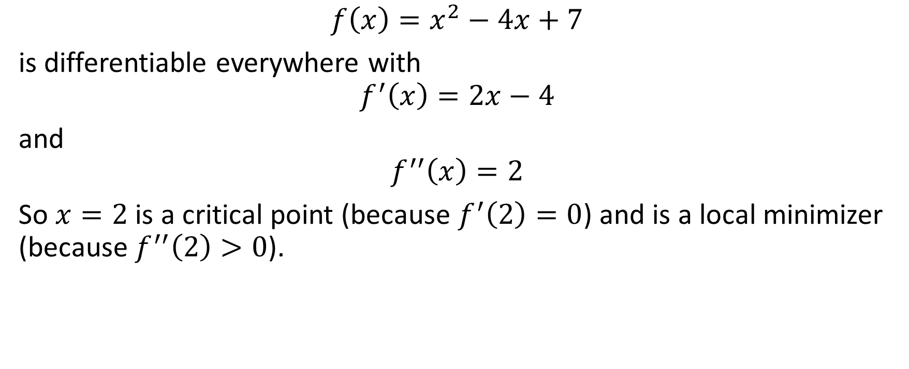
Example
$$f\left(x\right)=x^{2}−4x+7$$
is differentiable everywhere with
$$f^{′}\left(x\right)=2x−4$$
and
$$f^{′′}\left(x\right)=2$$
So $x=2$ is a critical point (because $f^{′}\left(2\right)=0$) and is a local minimizer (because $f^{′′}\left(2\right)>0$).

Slide 13
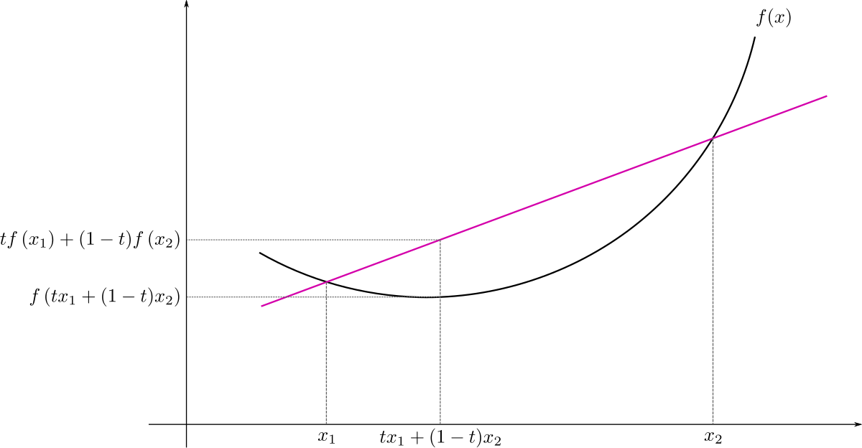

Convex functions
A function $f:ℝ→ℝ$ is convex if
$$∀x_{1},x_{2}∈ℝ, ∀t∈\left[0,1\right], f\left(\left(1−t\right)x_{1}+tx_{2}\right)≤\left(1−t\right)f\left(x_{1}\right)+tf(x_{2})$$
https://en.wikipedia.org/wiki/Convex_function

Slide 14
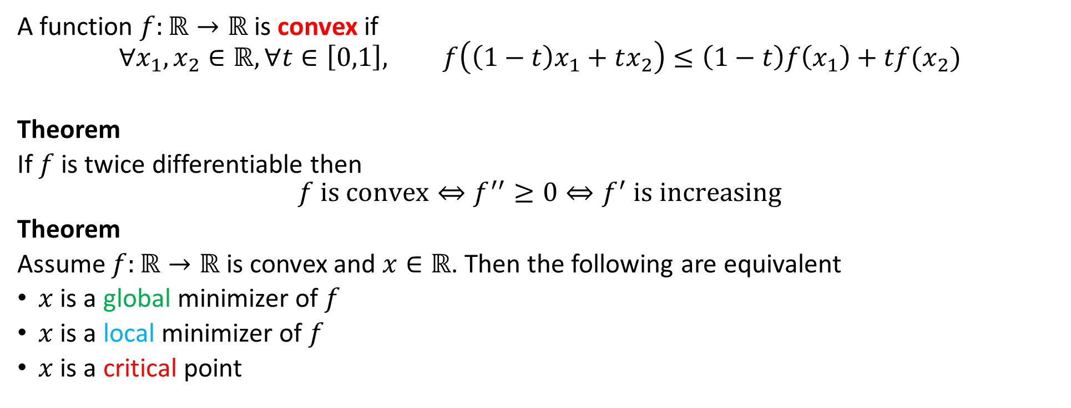
Convex functions
A function $f:ℝ→ℝ$ is convex if
$$∀x_{1},x_{2}∈ℝ, ∀t∈\left[0,1\right], f\left(\left(1−t\right)x_{1}+tx_{2}\right)≤\left(1−t\right)f\left(x_{1}\right)+tf(x_{2})$$
Theorem
If $f$ is twice differentiable then
$$f is convex⇔f^{′′}≥0⇔f^{′} is increasing$$
Theorem
Assume $f:ℝ→ℝ$ is convex and $x∈ℝ$. Then the following are equivalent
$x$ is a global minimizer of $f$
$x$ is a local minimizer of $f$
$x$ is a critical point
https://en.wikipedia.org/wiki/Convex_function

Slide 15
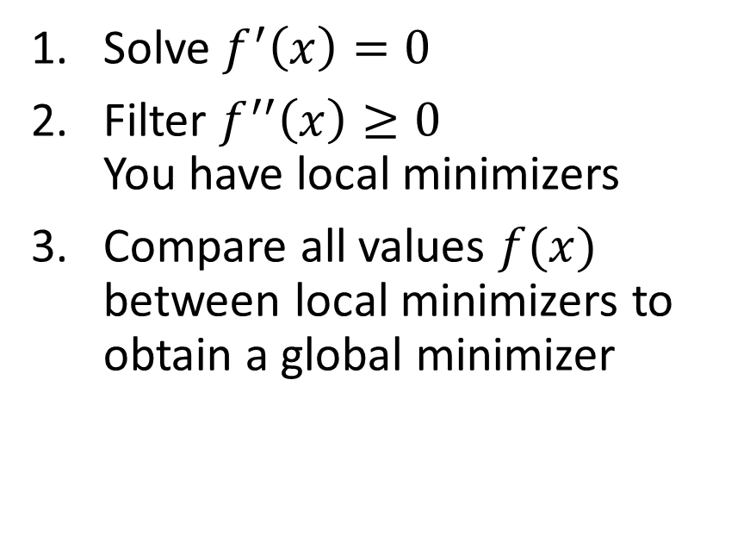

Finding a global minimizer
Convex
Nonconvex
Solve $f^{′}\left(x\right)=0$
Solve $f^{′}\left(x\right)=0$
Filter $f^{′′}\left(x\right)≥0$ You have local minimizers
Compare all values $f(x)$ between local minimizers to obtain a global minimizer

Slide 16
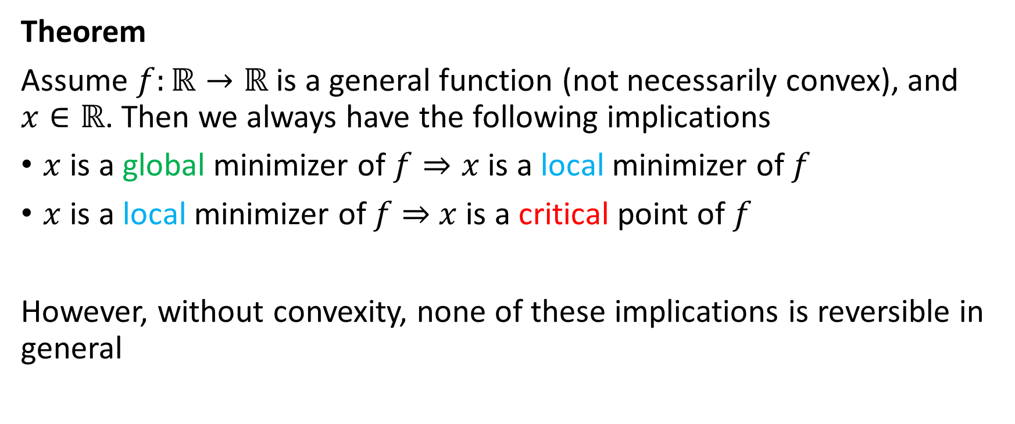
General functions
Theorem
Assume $f:ℝ→ℝ$ is a general function (not necessarily convex), and $x∈ℝ$. Then we always have the following implications
$x$ is a global minimizer of $f⇒x$ is a local minimizer of $f$
$x$ is a local minimizer of $f$ $⇒$ $x$ is a critical point of $f$
However, without convexity, none of these implications is reversible in general

Slide 17
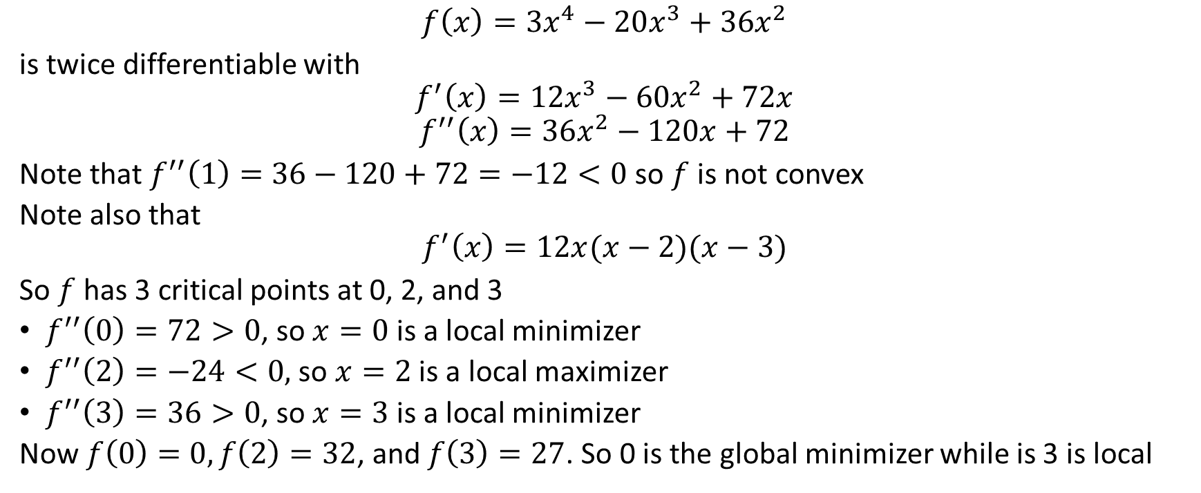
Nonconvex example
$$f\left(x\right)=3x^{4}−20x^{3}+36x^{2}$$
is twice differentiable with
$$f^{′}\left(x\right)=12x^{3}−60x^{2}+72x$$
$$f^{′′}\left(x\right)=36x^{2}−120x+72$$
Note that $f^{′′}\left(1\right)=36−120+72=−12<0$ so $f$ is not convex
Note also that
$$f^{′}\left(x\right)=12x(x−2)(x−3)$$
So $f$ has 3 critical points at 0, 2, and 3
$f^{′′}\left(0\right)=72>0$, so $x=0$ is a local minimizer
$f^{′′}\left(2\right)=−24<0,$ so $x=2$ is a local maximizer
$f^{′′}\left(3\right)=36>0$, so $x=3$ is a local minimizer
Now $f\left(0\right)=0, f\left(2\right)=32$, and $f\left(3\right)=27$. So 0 is the global minimizer while is 3 is local

Slide 18
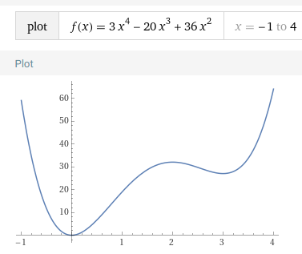
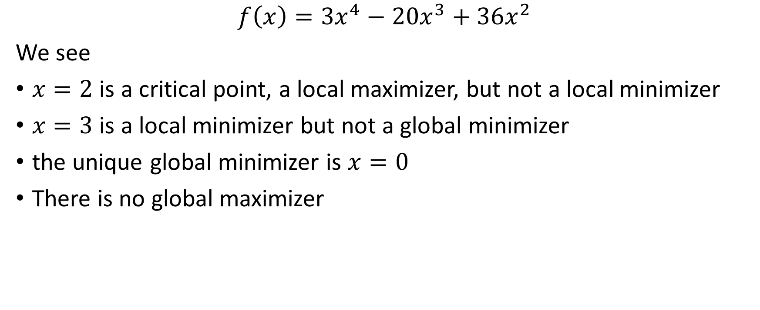
Nonconvex example
$$f\left(x\right)=3x^{4}−20x^{3}+36x^{2}$$
We see
$x=2$ is a critical point, a local maximizer, but not a local minimizer
$x=3$ is a local minimizer but not a global minimizer
the unique global minimizer is $x=0$
There is no global maximizer

Slide 19
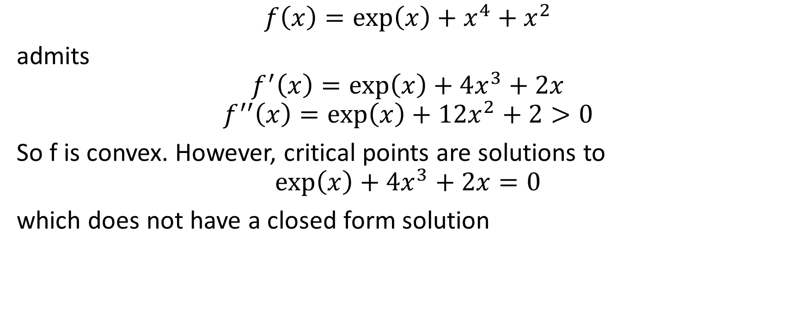
Finding critical points is hard!
$$f\left(x\right)=\exp\left(x\right)+x^{4}+x^{2}$$
admits
$$f^{′}\left(x\right)=\exp\left(x\right)+4x^{3}+2x$$
$$f^{′′}\left(x\right)=\exp\left(x\right)+12x^{2}+2>0$$
So f is convex. However, critical points are solutions to
$$\exp\left(x\right)+4x^{3}+2x=0$$
which does not have a closed form solution

Slide 20
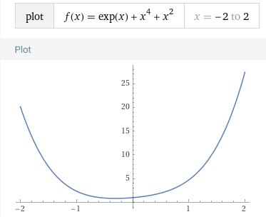
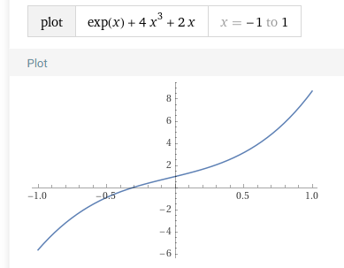
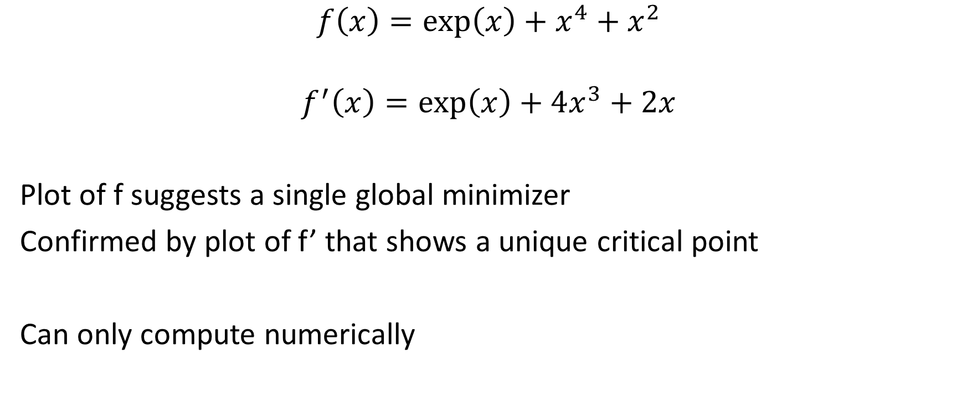
Hard convex function
$$f\left(x\right)=\exp\left(x\right)+x^{4}+x^{2}$$
$$f^{′}\left(x\right)=\exp\left(x\right)+4x^{3}+2x$$
Plot of f suggests a single global minimizer
Confirmed by plot of f’ that shows a unique critical point
Can only compute numerically

Slide 21
Gradient descent

Slide 22

Minimization algorithms
$$\min_{x}{f(x)}$$
Build a sequence $x_{0},x_{1}, x_{2}…$ with starting point $x_{0}$ such that
$$x_{n}→some minimizer of f$$
And
$$f\left(x_{n}\right)→the minimum value of f$$

Slide 23

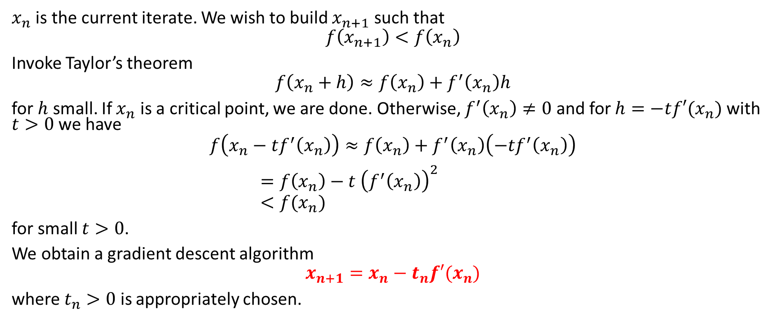

Descent direction
$$x_{n}$$
$$x_{n+1}$$
$x_{n}$ is the current iterate. We wish to build $x_{n+1}$ such that
$$f\left(x_{n+1}\right)<f\left(x_{n}\right)$$
Invoke Taylor’s theorem
$$f\left(x_{n}+h\right)≈f\left(x_{n}\right)+f^{′}\left(x_{n}\right)h$$
for $h$ small. If $x_{n}$ is a critical point, we are done. Otherwise, $f^{′}\left(x_{n}\right)≠0$ and for $h=−tf′(x_{n})$ with $t>0$ we have
$$f\left(x_{n}−tf^{′}\left(x_{n}\right)\right)≈f\left(x_{n}\right)+f^{′}\left(x_{n}\right)\left(−tf^{′}\left(x_{n}\right)\right)$$ $=f\left(x_{n}\right)−t {\left(f^{′}\left(x_{n}\right)\right)}^{2}$ $<f(x_{n})$
for small $t>0$.
We obtain a gradient descent algorithm
$$x_{n+1}=x_{n}−t_{n}f′(x_{n})$$
where $t_{n}>0$ is appropriately chosen.

Slide 24
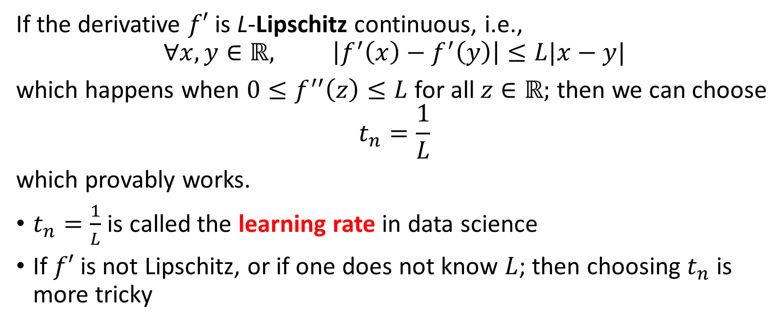

Finding $t_{n}$
If the derivative $f′$ is L-Lipschitz continuous, i.e.,
$$∀x,y∈ℝ, \left|f^{′}\left(x\right)−f^{′}\left(y\right)\right|≤L|x−y|$$
which happens when $0≤f^{′′}\left(z\right)≤L$ for all $z∈ℝ;$ then we can choose
$$t_{n}=\frac{1}{L}$$
which provably works.
$t_{n}=\frac{1}{L}$ is called the learning rate in data science
If $f′$ is not Lipschitz, or if one does not know $L$; then choosing $t_{n}$ is more tricky

Slide 25
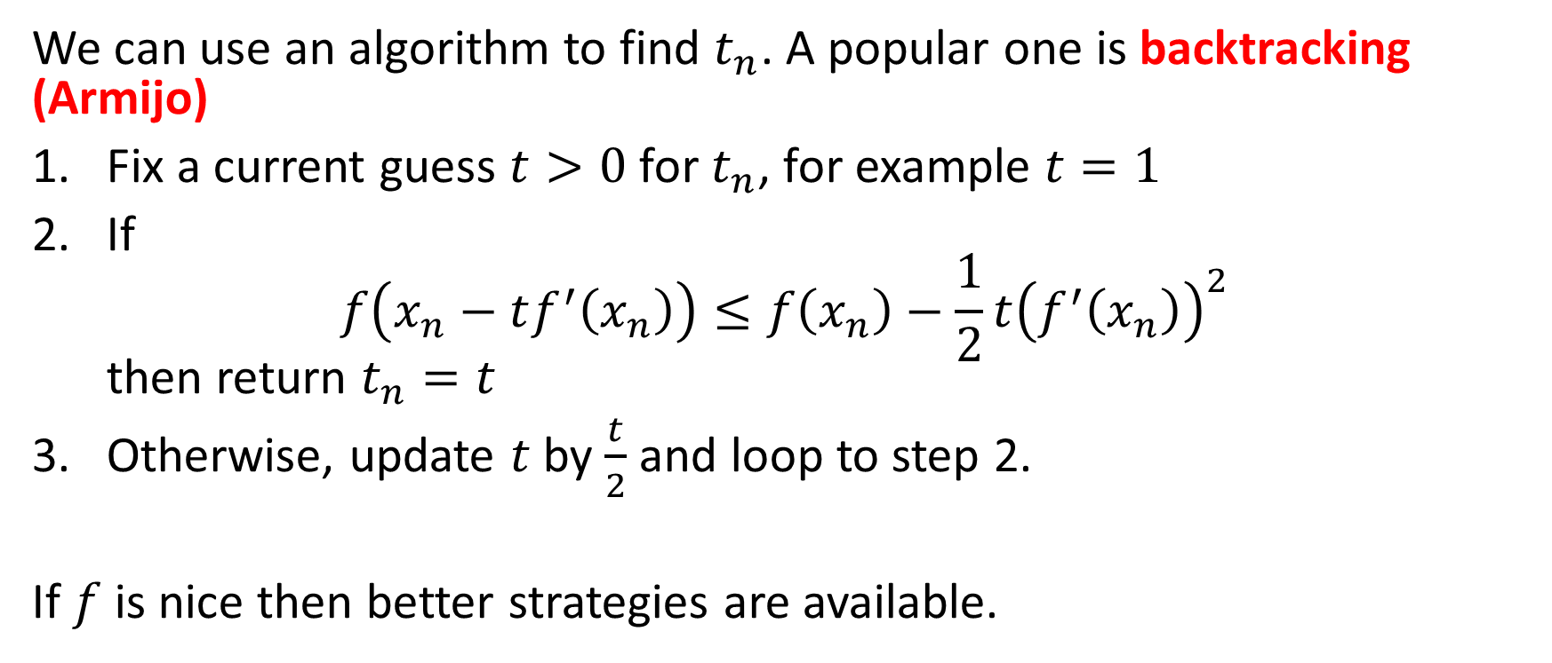
Finding $t_{n}$
We can use an algorithm to find $t_{n}$. A popular one is backtracking (Armijo)
Fix a current guess $t>0$ for $t_{n}$, for example $t=1$
If $f\left(x_{n}−tf^{′}\left(x_{n}\right)\right)≤f\left(x_{n}\right)−\frac{1}{2}t{\left(f^{′}\left(x_{n}\right)\right)}^{2}$ then return $t_{n}=t$
Otherwise, update $t$ by $\frac{t}{2}$ and loop to step 2.
If $f$ is nice then better strategies are available.

Slide 26
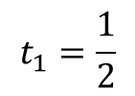
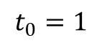
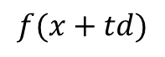
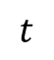
$$f(x+td)$$
$$t$$
$$t_{1}=\frac{1}{2}$$
$$t_{0}=1$$

Slide 27
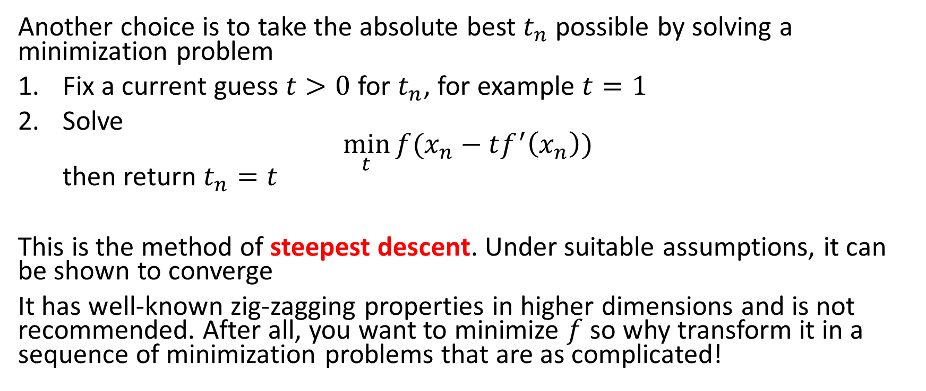
Finding $t_{n}$
Another choice is to take the absolute best $t_{n}$ possible by solving a minimization problem
Fix a current guess $t>0$ for $t_{n}$, for example $t=1$
Solve $\min_{t}{f(x_{n}−tf^{′}\left(x_{n}\right))}$ then return $t_{n}=t$
This is the method of steepest descent. Under suitable assumptions, it can be shown to converge
It has well-known zig-zagging properties in higher dimensions and is not recommended. After all, you want to minimize $f$ so why transform it in a sequence of minimization problems that are as complicated!

Slide 28
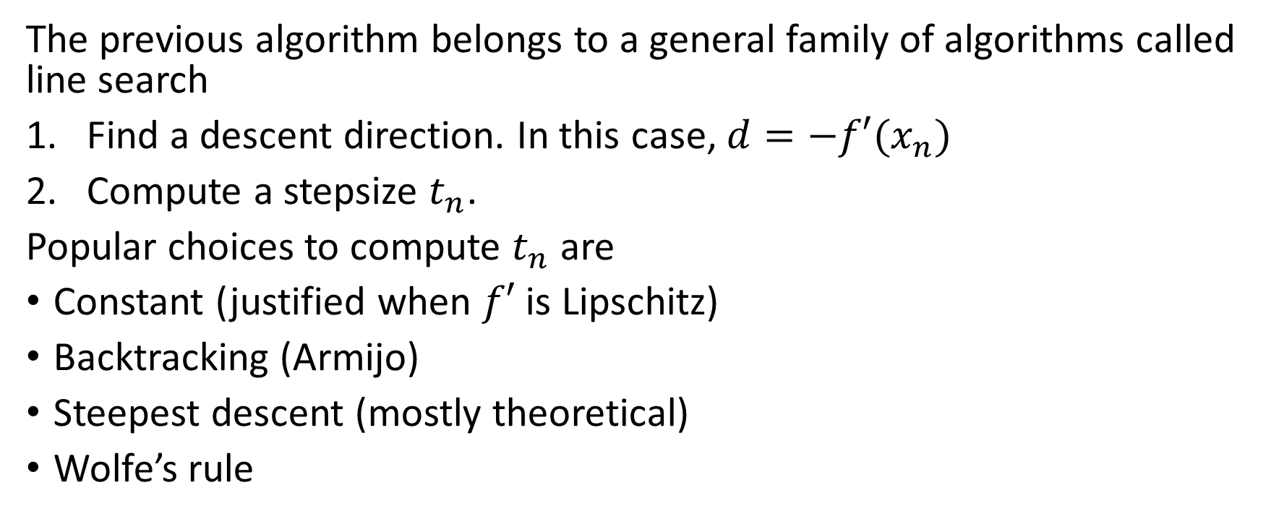
Line search
The previous algorithm belongs to a general family of algorithms called line search
Find a descent direction. In this case, $d=−f′(x_{n})$
Compute a stepsize $t_{n}$.
Popular choices to compute $t_{n}$ are
Constant (justified when $f′$ is Lipschitz)
Backtracking (Armijo)
Steepest descent (mostly theoretical)
Wolfe’s rule

Slide 29
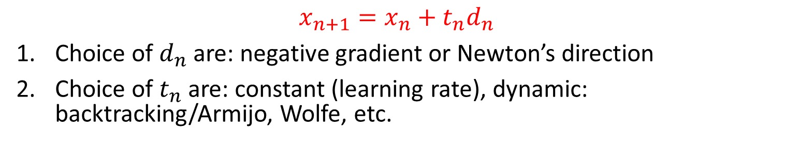
Now you know what a descent algorithm is
$$x_{n+1}=x_{n}+t_{n}d_{n}$$
Choice of $d_{n}$ are: negative gradient or Newton’s direction
Choice of $t_{n}$ are: constant (learning rate), dynamic: backtracking/Armijo, Wolfe, etc.

Slide 30
Newton

Slide 31
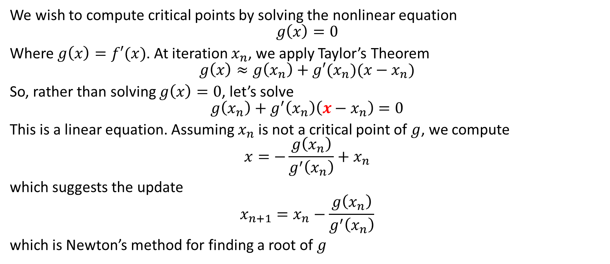
Roots of the derivative
We wish to compute critical points by solving the nonlinear equation
$$g\left(x\right)=0$$
Where $g\left(x\right)=f′(x)$. At iteration $x_{n}$, we apply Taylor’s Theorem
$$g\left(x\right)≈g\left(x_{n}\right)+g′(x_{n})(x−x_{n})$$
So, rather than solving $g\left(x\right)=0$, let’s solve
$$g\left(x_{n}\right)+g^{′}\left(x_{n}\right)\left(x−x_{n}\right)=0$$
This is a linear equation. Assuming $x_{n}$ is not a critical point of $g$, we compute
$$x=−\frac{g\left(x_{n}\right)}{g^{′}\left(x_{n}\right)}+x_{n}$$
which suggests the update
$$x_{n+1}=x_{n}−\frac{g\left(x_{n}\right)}{g^{′}\left(x_{n}\right)}$$
which is Newton’s method for finding a root of $g$

Slide 32
Ralf Pfeifer, CC BY-SA 3.0 <http://creativecommons.org/licenses/by-sa/3.0/>, via Wikimedia Commons
https://upload.wikimedia.org/wikipedia/commons/e/e0/NewtonIteration_Ani.gif

Slide 33
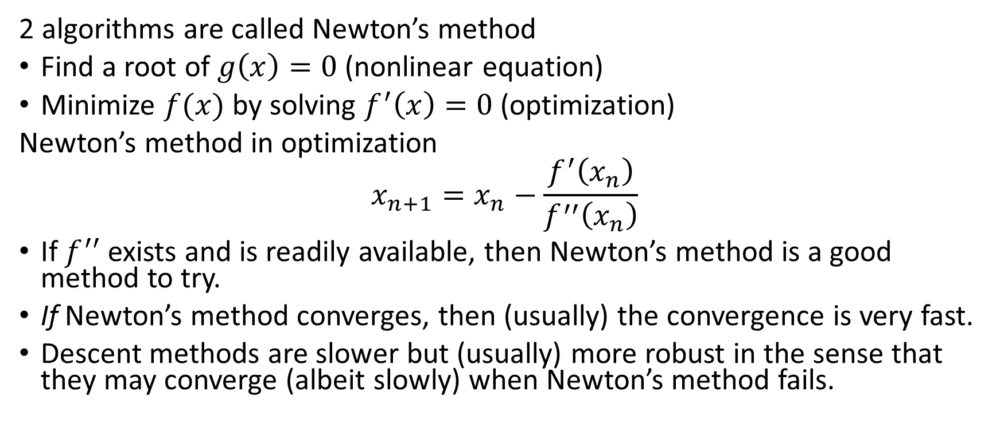
Newton’s method
2 algorithms are called Newton’s method
Find a root of $g\left(x\right)=0$ (nonlinear equation)
Minimize $f(x)$ by solving $f^{′}\left(x\right)=0$ (optimization)
Newton’s method in optimization
$$x_{n+1}=x_{n}−\frac{f^{′}\left(x_{n}\right)}{f^{′′}\left(x_{n}\right)}$$
If $f^{′′}$ exists and is readily available, then Newton’s method is a good method to try.
If Newton’s method converges, then (usually) the convergence is very fast.
Descent methods are slower but (usually) more robust in the sense that they may converge (albeit slowly) when Newton’s method fails.

Slide 34
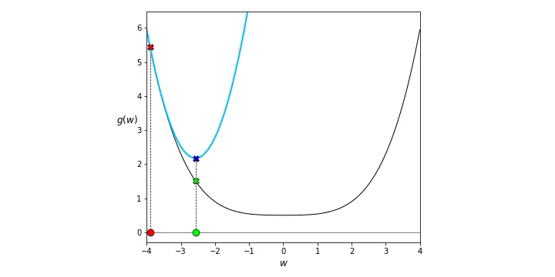
Creative Commons Attribution 4.0 International License (CC BY-NC-SA 4.0) attributed to Jeremy Watt and Reza Borhani https://github.com/jermwatt/machine_learning_refined/blob/gh-pages/LICENSE.md
https://github.com/jermwatt/machine_learning_refined/blob/gh-pages/presentations/2nd_edition/pptx%20version/Chapter%204/4.3%20%20Newton_s%20method.pptx

Slide 35
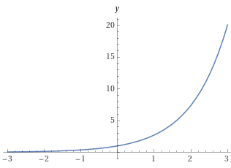
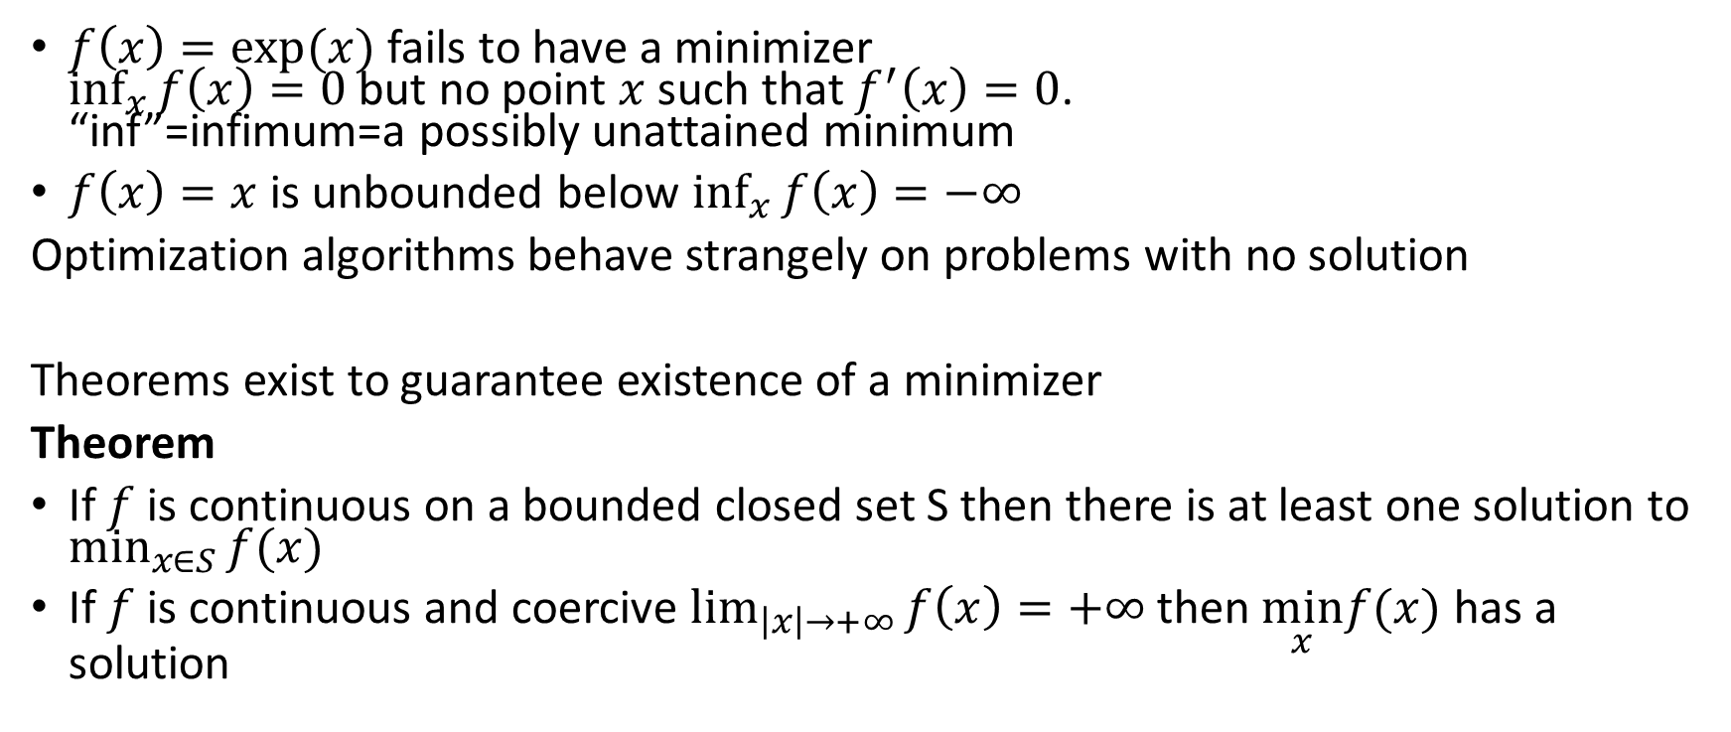
Some pitfalls
$f\left(x\right)=exp⁡(x)$ fails to have a minimizer $\inf_{x}{f\left(x\right)=0}$ but no point $x$ such that $f^{′}\left(x\right)=0$. “inf”=infimum=a possibly unattained minimum
$f\left(x\right)=x$ is unbounded below $\inf_{x}{f\left(x\right)=−∞}$
Optimization algorithms behave strangely on problems with no solution
Theorems exist to guarantee existence of a minimizer
Theorem
If $f$ is continuous on a bounded closed set S then there is at least one solution to $\min_{x∈S}{f(x)}$
If $f$ is continuous and coercive $\lim_{\left|x\right|→+∞}{f\left(x\right)=+∞}$ then $\min_{x}f(x)$ has a solution

Slide 36
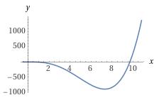
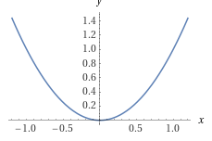
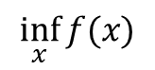
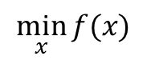
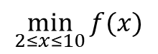
$$\inf_{x}{f(x)}$$
$$\min_{x}{f(x)}$$
$$\min_{2≤x≤10}{f(x)}$$

Slide 37
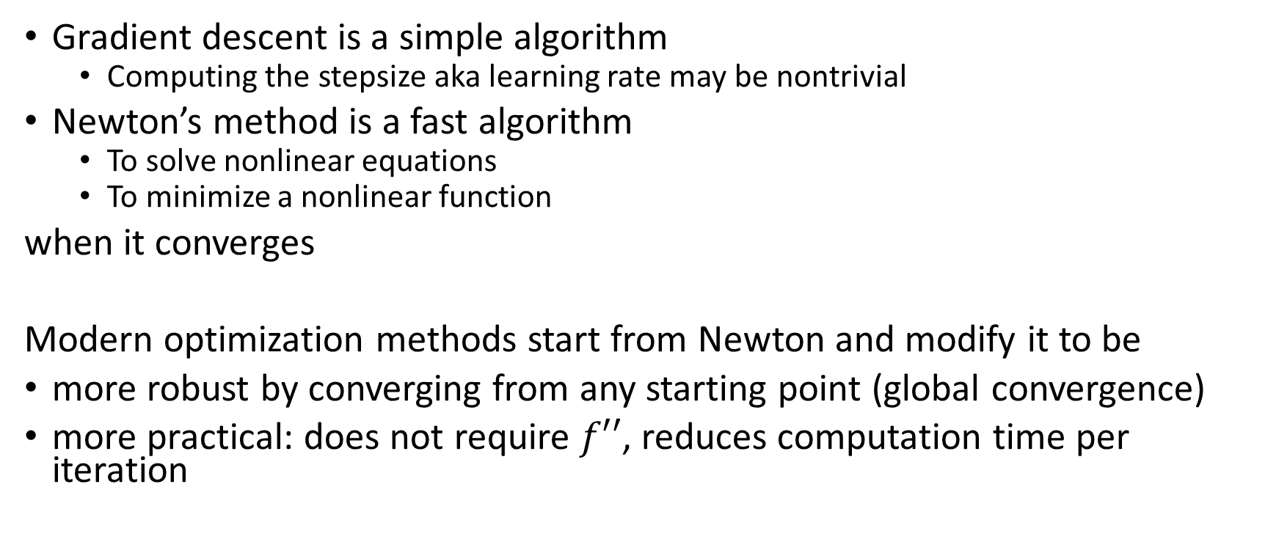
Take home
Gradient descent is a simple algorithm
Computing the stepsize aka learning rate may be nontrivial
Newton’s method is a fast algorithm
To solve nonlinear equations
To minimize a nonlinear function
when it converges
Modern optimization methods start from Newton and modify it to be
more robust by converging from any starting point (global convergence)
more practical: does not require $f′′$, reduces computation time per iteration

Slide 38
Convexity

Slide 39
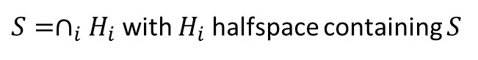

Convex sets
Inner definition
Outer definition
Any segment between any 2 points is in the set
Any supporting hyperplane does not intersect the set
$$S=\{x:x=t_{1}x_{1}+t_{2}x_{2}; x_{1},x_{2}∈S,;t_{1}+t_{2}=1;t_{1},t_{2}≥0\}$$
$S=∩_{i}H_{i}$ with $H_{i}$ halfspace containing $S$

Slide 40

Convex functions f is a convex function iff epi f is a convex set

Slide 41
https://en.wikipedia.org/wiki/Convex_function

Slide 42


Slide 43
Convexity tests
$f\left(λ_{1}x_{1}+λ_{2}x_{2}\right)≤λ_{1}f\left(x_{1}\right)+λ_{2}f\left(x_{2}\right)$
${\left[∇f\left(x_{1}\right)−∇f\left(x_{2}\right)\right]}^{T}\left(x_{1}−x_{2}\right)≥0$ $f′$ is nondecreasing
Hessian $∇^{2}f(x)$ has nonnegative eigenvalues $f′′$ is nonnegative
Practical test

Slide 44
$$f\left(x_{1},x_{2}\right)=x_{1}^{2}−x_{1}x_{2}$$
$$∇f\left(x_{1},x_{2}\right)=\left(\begin{matrix}2x_{1}−x_{2} \\ −x_{1}\end{matrix}\right)$$
$$∇^{2}f\left(x_{1},x_{2}\right)=\left[\begin{matrix}2 & −1 \\ −1 & 0\end{matrix}\right]$$
>> A=[2 -1; -1 0];
>> eigs(A)
ans =
2.4142
-0.4142
NONCONVEX

Slide 45






Convex optimization
$$\min_{x}{c^{T}x }$$
$Ax≤b, x∈C$
CP
$$\min_{x_{1},…,x_{n}}{\sum_{i,j}{c_{i,j}x_{i}^{T}x_{j}}}$$
$$\sum_{i,j}{a_{i,j,k}x_{i}^{T}x_{j}≤b_{k}}$$
SDP
SOQP
$\min_{x}f^{T}x$
$${\left|\left|A_{i}x+b_{i}\right|\right|}_{2}≤c_{i}^{T}x+d_{i}, i=1, …, m,$$
$Fx=g$
QP
$$\min_{x}{\frac{1}{2}x^{T}Qx+c^{T}x}$$
$$Ax≤b$$
Not always convex! Need $Q$ to be positive semidefinite
LP
$\min_{x}{c^{T}x }$
$Ax≤b, x≥0$

Slide 46

QCQP: quadratically constrained quadratic program
$$\min_{x}{\frac{1}{2}x^{T}P_{0}}x+q_{0}^{T}x$$
$$\frac{1}{2}x^{T}P_{i}x+q_{i}^{T}x+r_{i}≤0, i=1…m$$
$$Ax=b$$
Efficient solvers: Gurobi, CPLEX
Not always convex! Need all $P_{i}$ to be positive semi-definite

Slide 47
Summary
Critical point; Fermat’s rule
Second derivative test; convexity
Gradient descent; computing stepsize/learning rate; backtracking
Newton’s method: nonlinear equation/optimization
Convexity; local vs. global
Convex optimization problems

Slide 48
References
Any Calculus text you like. Free ones are available, e.g., at https://aimath.org/textbooks/approved-textbooks/
Very nice is the UBC collection at http://www.math.ubc.ca/~CLP/
Jorge Nocedal and Stephen J. Wright: Numerical Optimization, Springer. UBCO library: https://go.exlibris.link/WBm1qjRM
For derivatives: https://www.wolframalpha.com

